Slide 1

Digital Electronics and Computer Architecture
SCHOOL OF COMPUTER SCIENCE AND ENGINEERING

Slide 2

UNIT –II
Combinational Logic Design

Slide 3
Digital Electronics -Syllabus
Combinational Logic Design:
Design examples: Arithmetic circuits, Comparators, Code converters, Parity generators and checkers, Arithmatic and Logic Unit, design of adder and fast adder, look ahead carry generator, Implementation of SOP and POS using MUX,DEMUX,DECODER.

Slide 4
Design examples: Arithmetic circuits Half Adder & Full Adder Half Subtractor & Full Subtractor
1

Slide 5
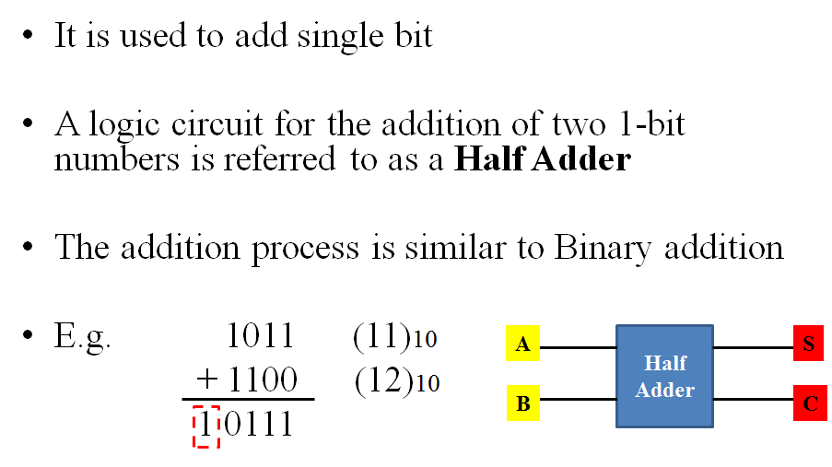
Half Adder

Slide 6
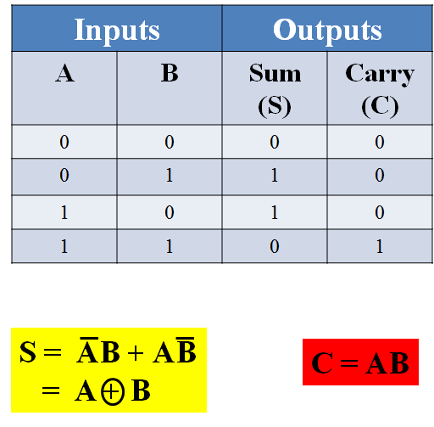
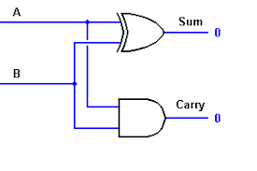
Half Adder

Slide 7
Half Subtractor
Subtracting a single-bit binary value Y from anther X (I.e. X -Y ) produces a difference bit D and a borrow out bit B-out.
This operation is called half subtraction and the circuit to realize it is called a half subtractor.
Half Subtractor Truth Table
Inputs
Outputs
X
Half
Subtractor
D
X
0
0
1
1
Y
0
1
0
1
D
0
1
1
0
B-out
0
1
0
0
D(X,Y) = Σ (1,2)
D = X’Y + XY’
D = X ⊕ Y
B-out(x, y, C-in) = Σ (1)
B-out = X’Y
Y
B-OUT
X
Y
Difference D
B-out

Slide 8
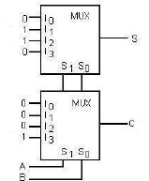
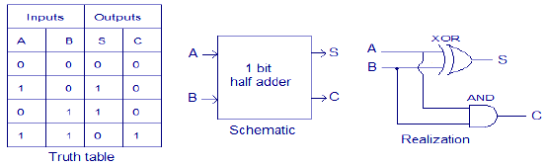
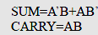
Half Adder USING 4:1 MUX :

Slide 9
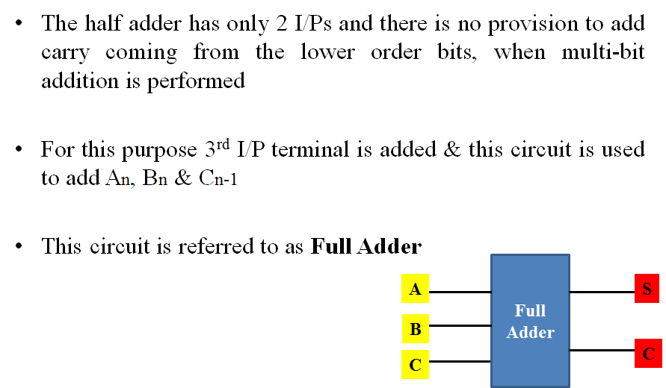
Full Adder

Slide 10
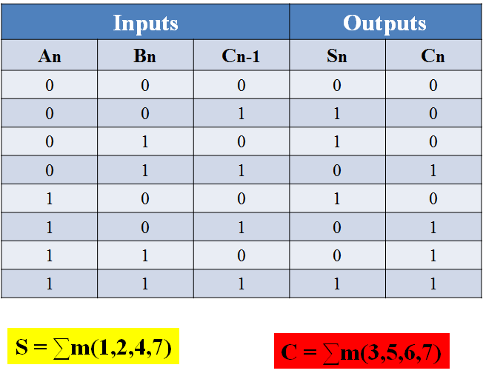
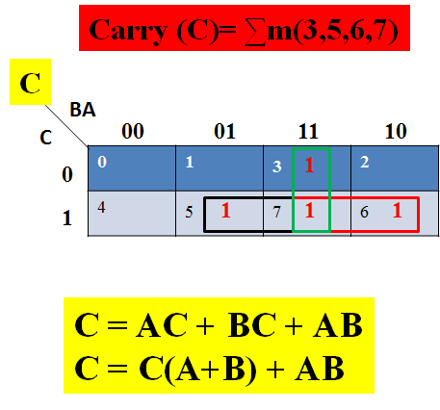
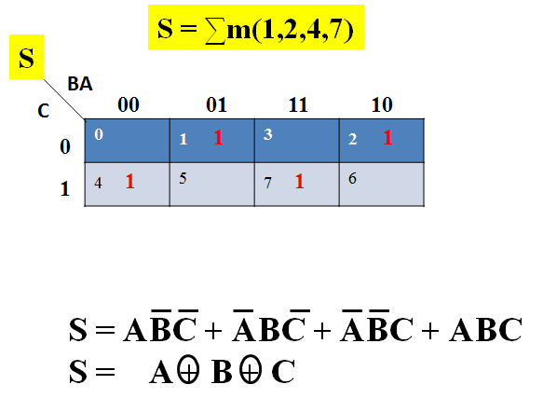
Full Adder Truth Table

Slide 11
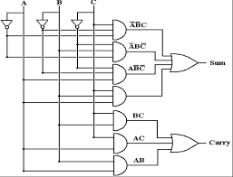
Full Adder Circuit (Sum & Carry) using Gates

Slide 12
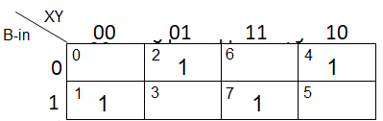
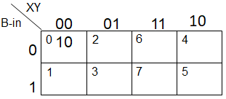
Full Subtractor
Subtracting two single-bit binary values, Y, B-in from a single-bit value X produces a difference bit D and a borrow out B-out bit. This is called full subtraction
Full Subtractor Truth Table
Difference D
X
0
0
0
0
1
1
1
1
Y
0
0
1
1
0
0
1
1
B-in
0
1
0
1
0
1
0
1
D
0
1
1
0
1
0
0
1
B-out
0
1
1
1
0
0
0
1
D = X’Y’(B-in) + XY’(B-in)’ + XY’(B-in)’ + XY(B-in)
D = X ⊕ Y ⊕ (B-in)
Borrow out B-out
D(X,Y, B-in) = Σ (1,2,4,7)
B-out(x, y, B-in) = Σ (1,2,3,7)
B-out = X’Y + X’(B-in) + Y(B-in)

Slide 13
Full Subtractor Circuit Using AND-OR
X
X’
OR
Y’
X’Y’B-in
X
X’
B-in
Difference D
X
Difference D
X’
X’YB-in’
Y
Y
Y
Y’
B-in’
Y
X
B-in
Y
B-in
B-in’
XY’B-in’
X
D = X’Y’(B-in) + XY’(B-in)’ + XY’(B-in)’ + XY(B-in)
D = X ⊕ Y ⊕ (B-in)
B-in
B-in’
Y
B-in’
XYB-in
X
Y
X’
X’Y
Y
X’
X’B-in
B-out
Full
Subtractor
B-in
B-in
B-out
Y
B-in
YB-in
D
B-out = X’Y + X’(B-in) + Y(B-in)

Slide 14
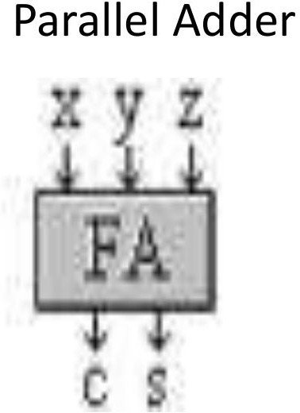
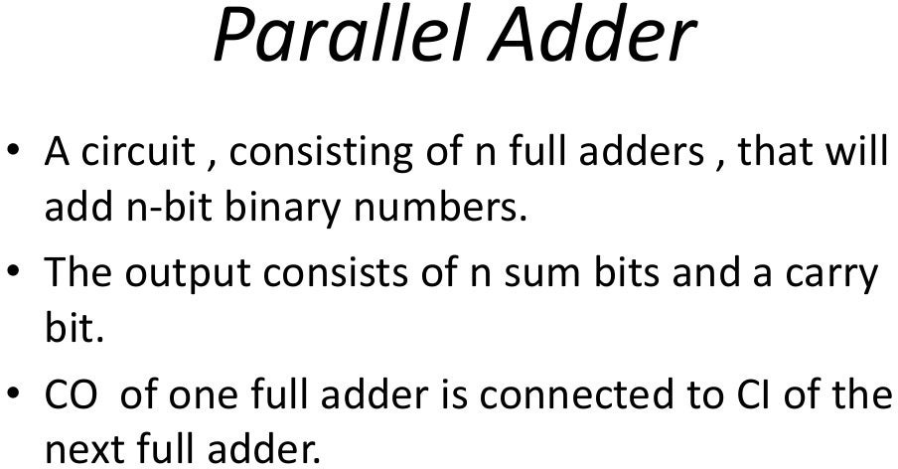
Parallel Adder

Slide 15
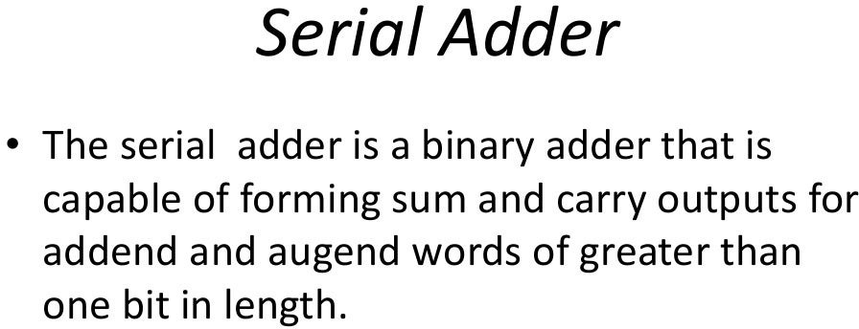
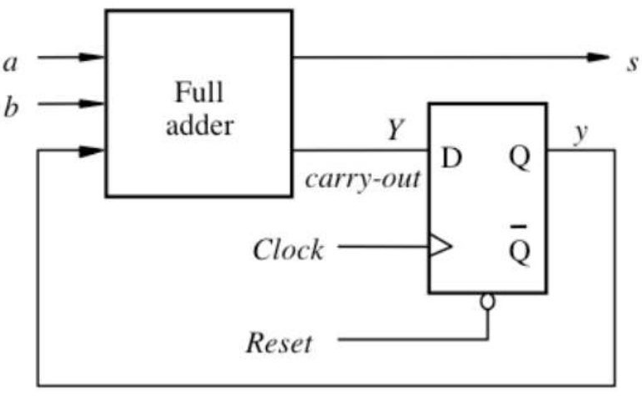
Serial Adder

Slide 16
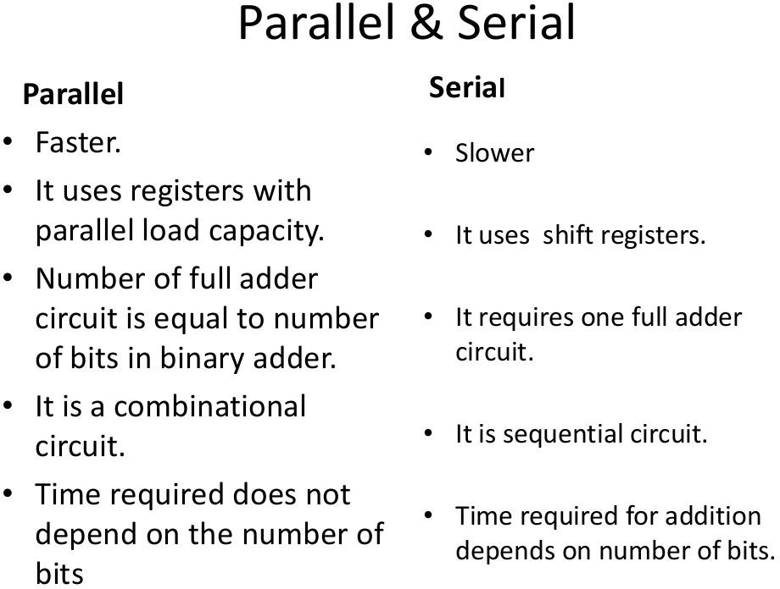
Comparison of Parallel and Serial Adder

Slide 17
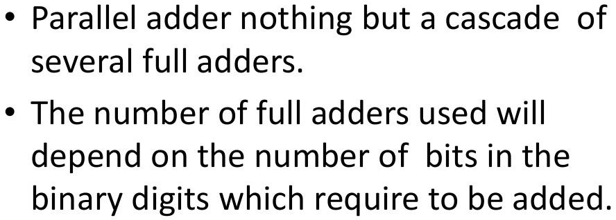
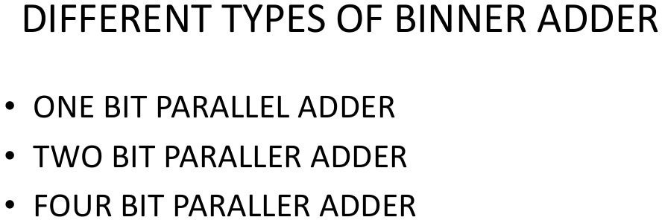
Structure of Parallel Adder
Types of Parallel Adders

Slide 18
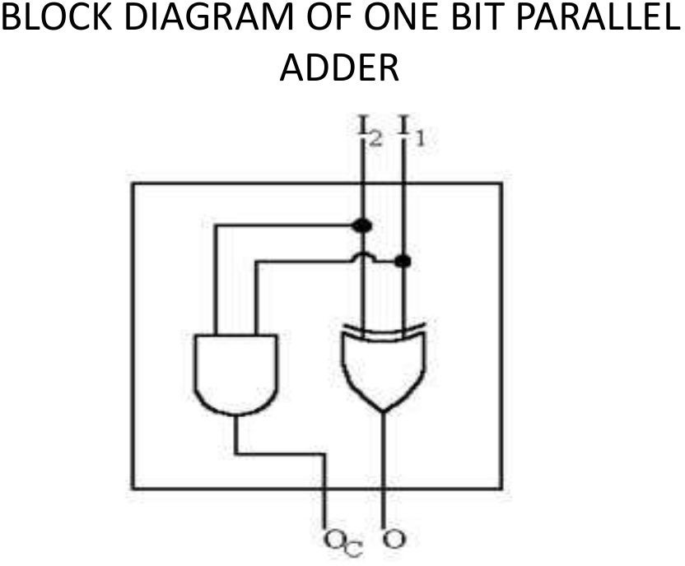
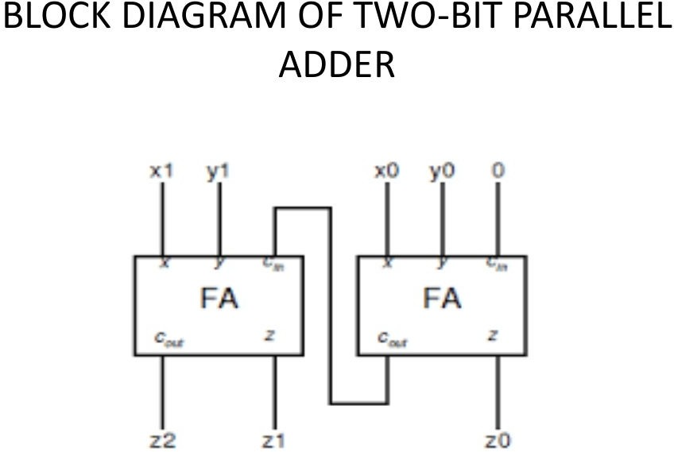
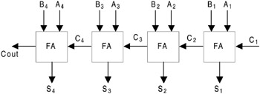
Types of Parallel Adders
One Bit Parallel Adder
Two Bit Parallel Adder
Four Bit Parallel Adder

Slide 19
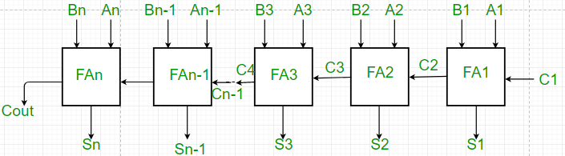
Working of Parallel Adder
As shown in the figure, firstly the full adder FA1 adds A1 and B1 along with the carry C1 to generate the sum S1 (the first bit of the output sum) and the carry C2 which is connected to the next adder in chain.
Next, the full adder FA2 uses this carry bit C2 to add with the input bits A2 and B2 to generate the sum S2(the second bit of the output sum) and the carry C3 which is again further connected to the next adder in chain and so on.
The process continues till the last full adder FAn uses the carry bit Cn to add with its input An and Bn to generate the last bit of the output along last carry bit Cout.

Slide 20
Advantages and Disadvantages of Parallel Adder
Advantages of parallel Adder –
The parallel adder performs the addition operation faster as compared to serial adder.
Time required for addition does not depend on the number of bits.
The output is in parallel form i.e all the bits are added/subtracted at the same time.
It is less costly.
Disadvantages of parallel Adder–
Each adder has to wait for the carry which is to be generated from the previous adder in chain.
The propagation delay( delay associated with the travelling of carry bit) is found to increase with the increase in the number of bits to be added.

Slide 21
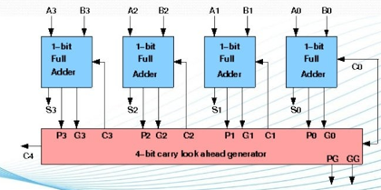
Carry Look-ahead Adder
A carry look-ahead adder reduces the propagation delay by introducing more complex hardware.

Slide 22
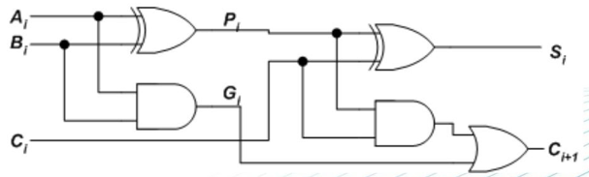
Carry Look-ahead Adder
A full adder in look ahead carry adder circuit is designed using two half adder circuits connected as shown. The circuit is design to reduce the dependency of next stage carry on previous stage carry
G_{i} = A_{i}B_{i} where G is called carry generator
P_{i} = A_{i} ⊕ B_{i} where P is called carry propagator

Slide 23
Carry Look-ahead Adder
G_{i} = A_{i}B_{i} where G is called carry generator
P_{i} = A_{i} ⊕ B_{i} where P is called carry propagator
Ci+1 = PiCi + Gi
For four bit parallel adder, Carry bits of all stages can be written as
C₁ = C₀P₀ + G₀ ………….. (1)
C₂ = C₁P₁ + G₁ ………….. (2)
C₃ = C₂P₂ + G₂ ………….. (3)
C₄ = C₃P₃ + G₃ ………….. (4)
Substituting (1) in (2), we get C₂ in terms of C₀. Then, substituting (2) in (3), we get C₃ in terms of C₀ and so on.
C₁ = C₀P₀ + G₀
C₂ = C₀P₀P₁ + G₀P₁ + G₁
C₃ = C₀P₀P₁P₂ + G₀P₁P₂ + G₁P₂ + G₂
C₄ =C₀P₀P₁P₂P3 + G₀P₁P₂P₃ + G₁P₂P₃ + G₂P₃ + G₃
As Gi and Pi depend only on Ai and Bi, dependency of next carry being dependent on previous carry is reduced.

Slide 24
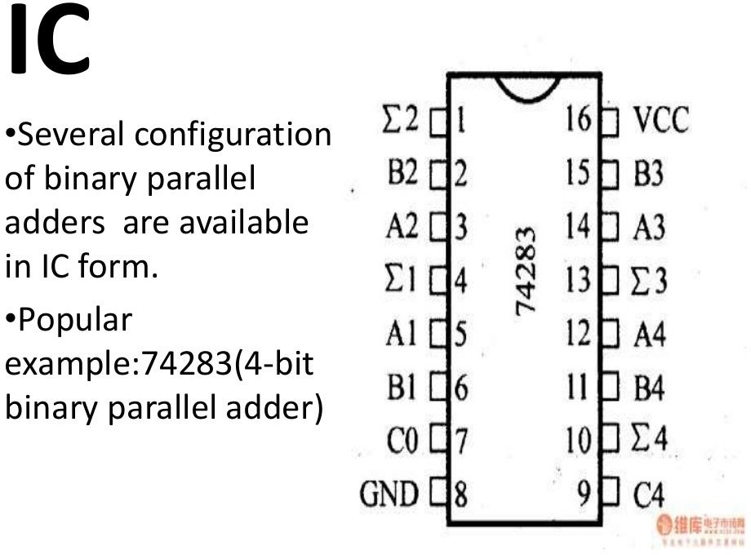

Slide 25
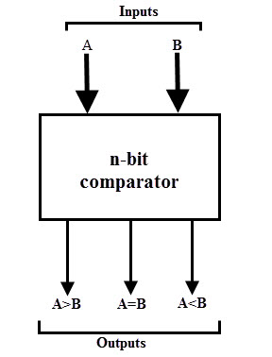
Digital Comparator
A digital comparator is a combinational circuit that compares two digital or binary numbers (consider A and B) and determines their relative magnitudes in order to find out whether one number is equal, less than or greater than the other digital number.
Three binary variables are used to indicate the outcome of the comparison as A>B, A<B, or A=B.
The figure shows the block diagram of a n-bit comparator which compares the two numbers of n-bit length and generates their relation between themselves.

Slide 26
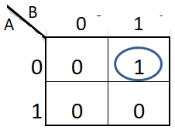
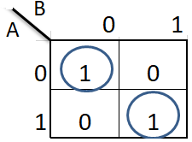
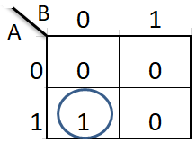
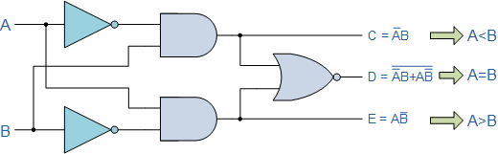
Digital Comparator
Y(A<B)
Y(A=B)
Y(A>B)
Input |  | Output
A | B | A<B | A=B | A>B
0 | 0 | 0 | 1 | 0
0 | 1 | 1 | 0 | 0
1 | 0 | 0 | 0 | 1
1 | 1 | 0 | 1 | 0
Y(A<B) = A’B
Y(A=B) = A’B’ + AB
Y(A>B) = AB’

Slide 27
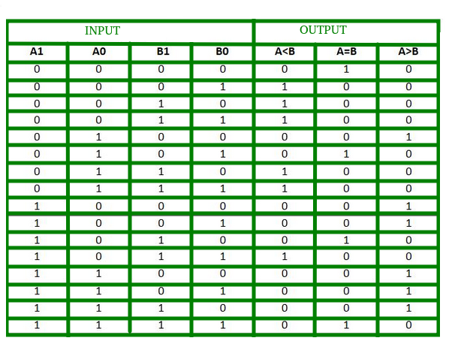
2-Bit Digital Comparator

Slide 28
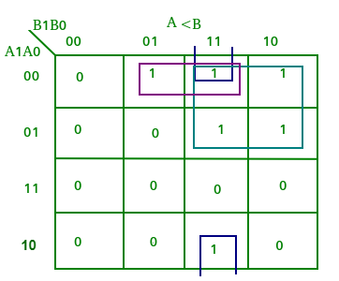
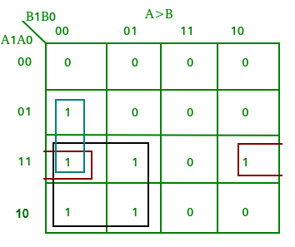
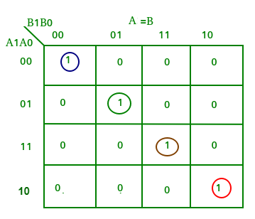
2-Bit Digital Comparator
A<B: A1’B1 + A0’B1B0 + A1’A0’B0
A>B= A1B1’+ A0B1’B0’+ A1A0B0’
A=B: A1’A0’B1’B0’ + A1’A0B1’B0 + A1A0B1B0 + A1A0’B1B0’
: A1’B1’ (A0’B0’ + A0B0) + A1B1 (A0B0 + A0’B0’)
: (A0B0 + A0’B0’) (A1B1 + A1’B1’)
: (A0 Ex-Nor B0) (A1 Ex-Nor B1)

Slide 29
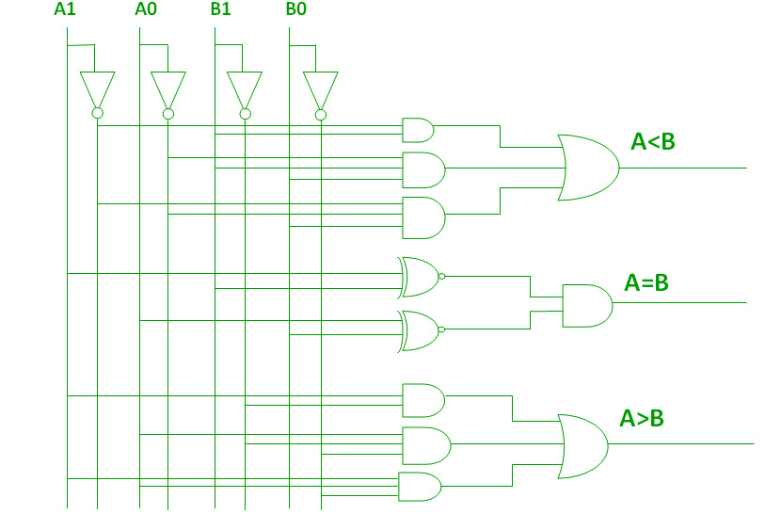
2-Bit Digital Comparator

Slide 30
4-Bit Digital Comparator
A 4 bit comparator compares two 4 bit binary numbers
The inputs are A(A3,A2,A1,A0) and B (B3,B2,B1,B0)
In a 4-bit comparator the condition of A>B can be possible in the following four cases:
If A3 = 1 and B3 = 0
If A3 = B3 and A2 = 1 and B2 = 0
If A3 = B3, A2 = B2 and A1 = 1 and B1 = 0
If A3 = B3, A2 = B2, A1 = B1 and A0 = 1 and B0 = 0
The condition for A<B can be possible in the following four cases:
If A3 = 0 and B3 = 1
If A3 = B3 and A2 = 0 and B2 = 1
If A3 = B3, A2 = B2 and A1 = 0 and B1 = 1
If A3 = B3, A2 = B2, A1 = B1 and A0 = 0 and B0 = 1
The condition of A=B is possible only when all the individual bits of one number exactly coincide with corresponding bits of another number

Slide 31
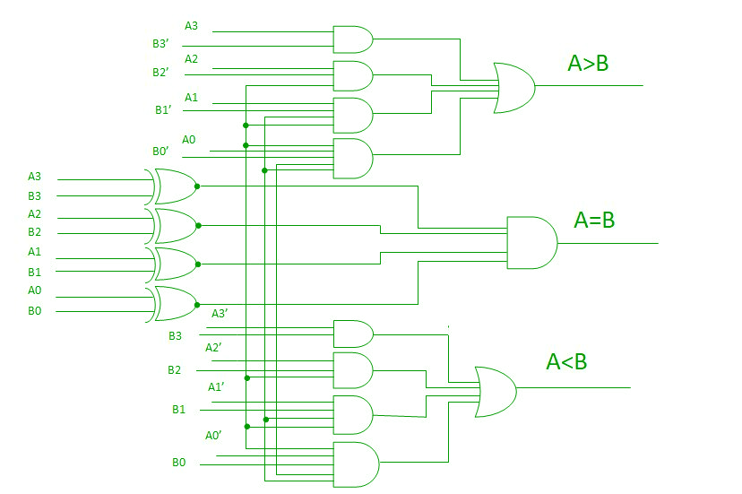
Schematic of 4-Bit Digital Comparator

Slide 32
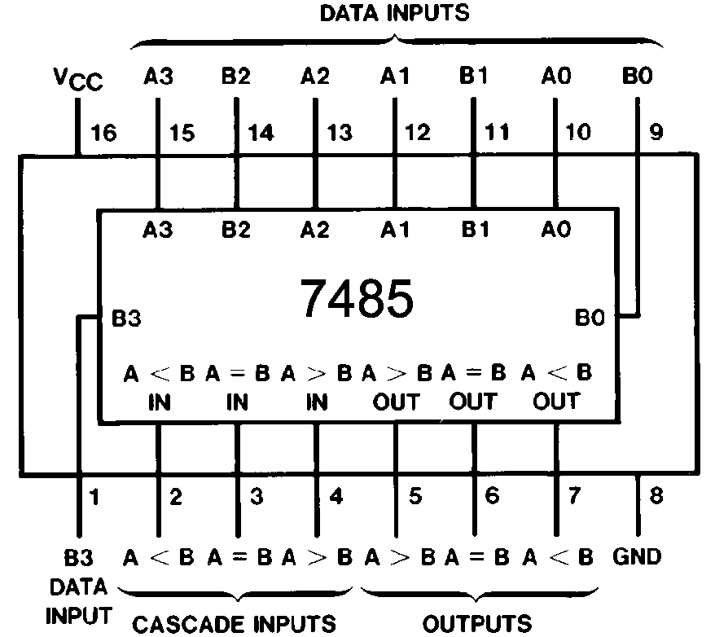
IC 7485: 4-Bit Digital Comparator

Slide 33
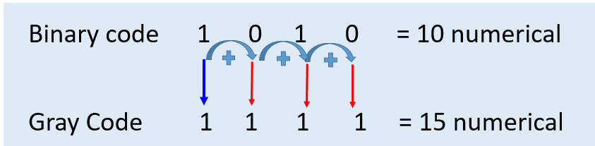
4-Bit Binary to gray and vice versa conversion
The most significant bit (MSB) of the Gray code is always equal to the MSB of the given binary code other bits of the output Gray code can be obtained by Xoring binary code bit at that index and previous index.
Ex-OR Truth Table
A | B | Output
0 | 0 | 0
0 | 1 | 1
1 | 0 | 1
1 | 1 | 0

Slide 34
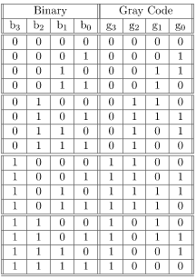
4-Bit Binary to gray conversion Truth Table

Slide 35
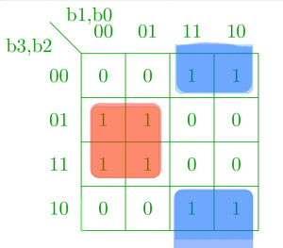
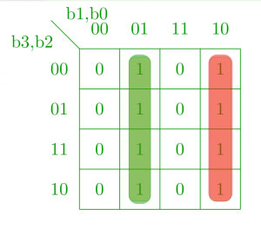
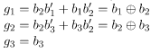
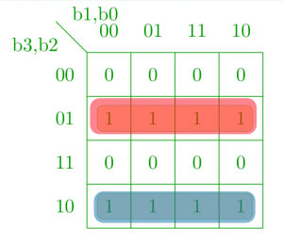
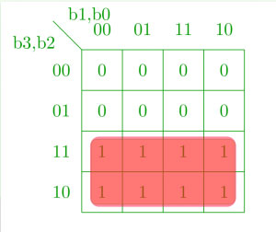
4-Bit Binary to gray and vice versa conversion
g0
g1
g2
g3

Slide 36
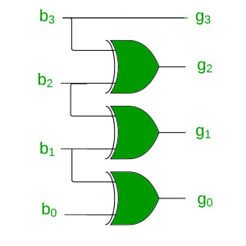
4-Bit Binary to Gray code Circuit diagram

Slide 37
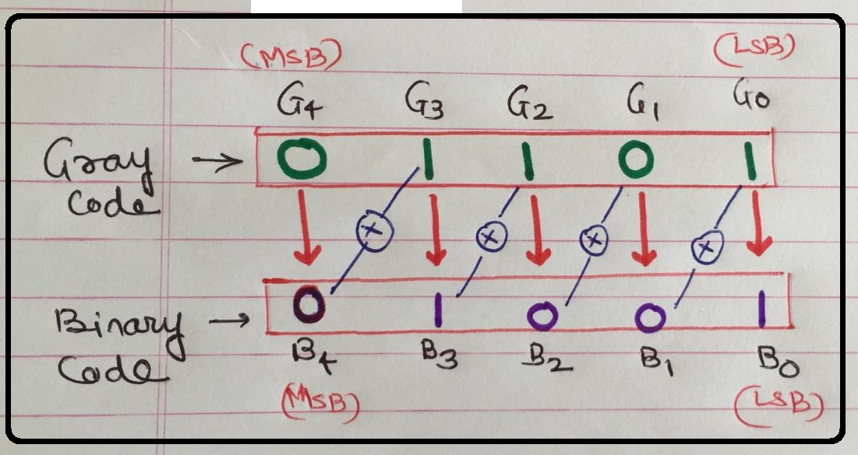
4-Bit Gray to Binary conversion process

Slide 38
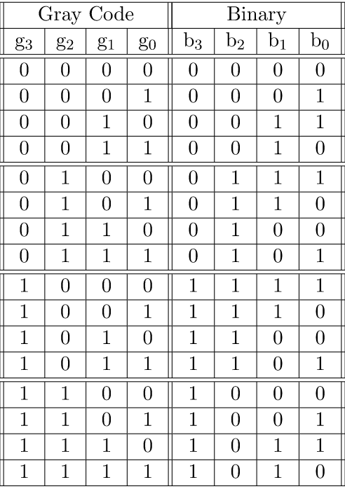
4-Bit Gray to Binary conversion truth table-Method1

Slide 39
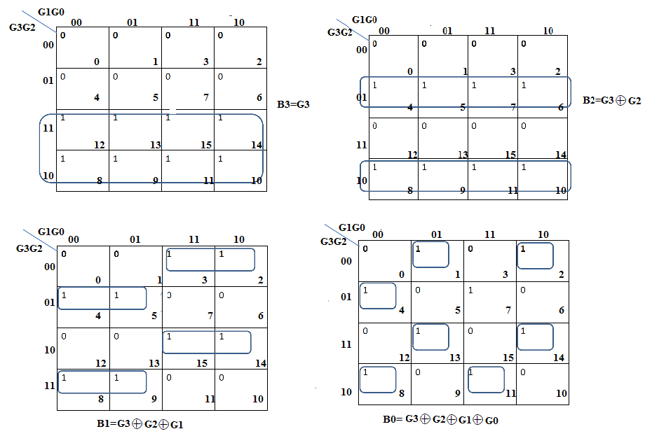
4-Bit Gray to Binary conversion Equation

Slide 40

4-Bit Gray to Binary conversion

Slide 41

BCD to 7 Segment Decoder

Slide 42

BCD to 7 Segment Decoder
BCD (Binary Coded Decimal) is an encoding scheme which represents each of the decimal numbers by its equivalent 4-bit binary pattern.
Seven segment displays comprise of seven individual segments formed by either Light Emitting Diodes (LEDs) or Liquid Crystal Displays (LCDs) arranged in a definite pattern

Slide 43


BCD to 7 Segment Decoder
Common Cathode
In such type of 7-segment display, all the cathodes of the 7 LEDs are connected together to form a common terminal. It should be connected to GND or logic ‘0’ during its operation.
To illuminate any LED of the display, you need to supply logic ‘1’ to its corresponding input pin.
Common Anode
The type of 7-Segment display in which all the anode terminals of 7 LEDs are connected together to form common anode terminal. This terminal should be connected with Vcc or logic ‘1’ during its operation.
To illuminate any of the LED segments we need to provide logic ‘0’ to it.

Slide 44


BCD to 7 Segment Decoder
BCD to seven segment decoder is a circuit used to convert the input BCD into a form suitable for the display.
It has four input lines (A, B, C and D) and 7 output lines (a, b, c, d, e, f and g) as shown.
Considering common cathode type of arrangement, the truth table for the decoder .

Slide 45

BCD to 7 Segment Decoder
Truth table for common cathode type BCD to seven segment decoder
However, it is to be noted that in the case of common anode type, the only change will be to interchange ones and zeros on the table.

Slide 46

BCD to 7 Segment Decoder
A0, A1, A2, A3 are the BCD input pins.
LT - for display test
RBO, RBI is the Ripple blanking output and Ripple blanking Input pins respectively.
a, b, c, d, e, f, g are the outputs for seven segment display.

Slide 47
Parity Generator / Checker
There are two types of parity codes, namely even parity code and odd parity code based on the type of parity being chosen.
Even Parity Code
The value of even parity bit should be zero, if even number of ones present in the binary code. Otherwise, it should be one. So that, even number of ones present in even parity code.
Odd Parity Code
The value of odd parity bit should be zero, if odd number of ones present in the binary code. Otherwise, it should be one. So that, odd number of ones present in odd parity code

Slide 48

Table-1 shows the 3-bit message with even parity & odd parity
3-bit message |  |  | Odd parity bit | Even parity bit
A | B | C
0 | 0 | 0 | 1 | 0
0 | 0 | 1 | 0 | 1
0 | 1 | 0 | 0 | 1
0 | 1 | 1 | 1 | 0
1 | 0 | 0 | 0 | 1
1 | 0 | 1 | 1 | 0
1 | 1 | 0 | 1 | 0
1 | 1 | 1 | 0 | 1
Even Parity
BC A | 00 | 01 | 11 | 10
0 | 0 0 | 1 1 | 0 3 | 1 2
1 | 1 4 | 0 5 | 1 7 | 0 6

Slide 49
Table-1 shows the 3-bit message with even parity & odd parity
3-bit message |  |  | Odd parity bit | Even parity bit
A | B | C
0 | 0 | 0 | 1 | 0
0 | 0 | 1 | 0 | 1
0 | 1 | 0 | 0 | 1
0 | 1 | 1 | 1 | 0
1 | 0 | 0 | 0 | 1
1 | 0 | 1 | 1 | 0
1 | 1 | 0 | 1 | 0
1 | 1 | 1 | 0 | 1
Odd Parity
BC A | 00 | 01 | 11 | 10
0 | 1 0 | 0 1 | 1 3 | 0 2
1 | 0 4 | 1 5 | 0 7 | 1 6

Slide 50
Parity Detector/ Checker:
The three bits in the message together with the parity bit are transmitted to the destination, where they are applied to the parity checker circuit.
The parity checker circuit checks for possible errors in the transmission. Since the information was transmitted with even parity , the four bits received must have an even number of 1’s.
An error occurs during the transmission if the four bits received have an odd number of 1’s, indicating that one bit has changed in value during transmission.
The output of the parity checker is denoted by PEC (Parity Error Check).
It will be equal to 1 , if an error occurs , that is if the four bits received have an odd number of 1’s.

Slide 51
Parity Detector/ Checker: Truth Table for Even Parity Checker
Four Bits Received |  |  |  | Parity Error Check
A | B | C | D | PEC
0 | 0 | 0 | 0 | 0
0 | 0 | 0 | 1 | 1
0 | 0 | 1 | 0 | 1
0 | 0 | 1 | 1 | 0
0 | 1 | 0 | 0 | 1
0 | 1 | 0 | 1 | 0
0 | 1 | 1 | 0 | 0
0 | 1 | 1 | 1 | 1
1 | 0 | 0 | 0 | 1
1 | 0 | 0 | 1 | 0
1 | 0 | 1 | 0 | 0
1 | 0 | 1 | 1 | 1
1 | 1 | 0 | 0 | 0
1 | 1 | 0 | 1 | 1
1 | 1 | 1 | 0 | 1
1 | 1 | 1 | 1 | 0

Slide 52

Parity Detector/ Checker: Even parity checker.

Slide 53
Parity Detector/ Checker: Truth table for the Odd parity checker.
Four bits received |  |  |  | Parity Error Check
A | B | C | D | PEC
0 | 0 | 0 | 0 | 1
0 | 0 | 0 | 1 | 0
0 | 0 | 1 | 0 | 0
0 | 0 | 1 | 1 | 1
0 | 1 | 0 | 0 | 0
0 | 1 | 0 | 1 | 1
0 | 1 | 1 | 0 | 1
0 | 1 | 1 | 1 | 0
1 | 0 | 0 | 0 | 0
1 | 0 | 0 | 1 | 1
1 | 0 | 1 | 0 | 1
1 | 0 | 1 | 1 | 0
1 | 1 | 0 | 0 | 1
1 | 1 | 0 | 1 | 0
1 | 1 | 1 | 0 | 0
1 | 1 | 1 | 1 | 1

Slide 54

Parity Detector/ Checker: K-Map for the Odd parity checker.

Slide 55


Arithmetic Logic Unit
The ALU is an extremely versatile and useful device since, it makes available, in single package, facility for performing many different logical and arithmetic operations.
Arithmetic Logic Unit (ALU) is a critical component of a microprocessor and is the core component of central processing unit.

Slide 56
Arithmetic Logic Unit
ALU’s comprise the combinational logic that implements logic operations such as AND, OR and arithmetic operations, such as ADD, SUBTRACT.
lets construct a simple ALU that performs a arithmetic operation (1 bit addition)and does 3 logical operations namely AND, NOR and XOR
The multiplexer selects only one operation at a time.
The operation selected depends on the selection lines of the multiplexer as shown in the truth table.

Slide 57

Arithmetic Logic Unit
M1 | M0 | Operations
0 | 0 | SUM
0 | 1 | OR
1 | 0 | AND
1 | 1 | EXOR

Slide 58

Arithmetic Logic Unit
Four 1 bit ALU’s can be concatenated to design 4 bit ALU

Slide 59

Arithmetic Logic Unit
The ALU IC has more functions as compared to 1 bit ALU
The diagram shows 4 bit ALU having capability to performing logical as well as arithmetic operations.
Controlled by the four function select inputs (S0 to S3) and the mode control input (M), ALU can perform all the 16 possible logic operations or 16 different arithmetic operations on active HIGH or active LOW operands.
It is designed using look ahead carry capability

Slide 60

Arithmetic Logic Unit
When the mode control input (M) is HIGH, all internal carries are inhibited and the device performs logic operations on the individual bits.
When M is LOW, the carries are enabled and the ALU performs arithmetic operations on the two 4-bit words.

Slide 61
Multiplexer and Demultiplexer

Slide 62


Communication System
Communication System
Transmitting End
Receiving End
1
2
N
1
2
M
Channel
Data Selector
Data Distributor

Slide 63
Communication System
Communication System
Transmitting End
Receiving End
Transmitting End
Channel
Data Selector
Data Distributor

Slide 64



Multiplexer
Data Selector or Many to one circuit

Slide 65
Multiplexer
Advantages of Mux
Reduces the number of wires
Reduces circuit complexity & cost
Minimize the IC package count
Types
2:1 MUX
4:1 MUX
8:1 MUX
16:1 MUX
65

Slide 66

2:1 Multiplexer

Slide 67



2:1 Multiplexer Circuit
Gate level circuit diagram of 2:1 Multiplexer.

Slide 68


4:1 Multiplexer
Inputs |  |  | Output
E | S1 | S0 | Y
0 | X | X | 0
1 | 0 | 0 | I0
1 | 0 | 1 | I1
1 | 1 | 0 | I2
1 | 1 | 1 | I3
68

Slide 69

4:1 Multiplexer
Inputs |  | Output
S1 | S0 | Y
0 | 0 | I0
0 | 1 | I1
1 | 0 | I2
1 | 1 | I3
69

Slide 70








4:1 Multiplexer

Slide 71
Implementation of Logic expressions using Multiplexers
In method 1, type of mux can be decided by the given number of variables.
The first step is to select the multiplexer. If the given expression has n variables, then determine the multiplexer using the formula 2^{n} : 1.
Connect the inputs, that correspond to the given minterms to logic 1.
Connect all the other inputs to the ground(logic 0).
Connect the input variables(A, B, C….) as the selection lines.

Slide 72

Implementation of Logic expressions using Multiplexers
Implement the boolean expression F(A, B, C) = ∑ m(2, 3, 6, 7) using a multiplexer.
Solution:
There are 3 variables in the given expression, hence 2^{n} = 2³ = 8 : 1 multiplexer.
So, the mux has 8 input lines, 3 selection lines, and one output.
The inputs, corresponding to the minterms (2, 3, 6, 7) are connected to the logic 1 and remaining terms to the logic 0(grounded).
The given input variables are connected as three selection lines.

Slide 73

Implementation of Logic expressions using Multiplexers
Implement the Boolean expression F(A, B) = ∑ m(0, 3) using a multiplexer.
Solution:
There are 2 variables in the given expression, hence 2^{n} = 2² = 4 : 1 multiplexer.
So, the mux has 4 input lines, 2 selection lines, and one output.
The inputs, corresponding to the minterms (0, 3) are connected to the logic 1 and remaining terms to the logic 0(grounded).
The given input variables are connected as two selection lines.

Slide 74

Implementation of Logic expressions using Multiplexers
Implement the boolean expression F(A, B) = π M(0, 3) using a multiplexer.
Solution:
There are 2 variables in the given expression, hence 2^{n} = 2² = 4 : 1 multiplexer.
So, the mux has 4 input lines, 2 selection lines, and one output.
The inputs, corresponding to the maxterms (0, 3) are connected to the logic 0 and remaining terms to the logic 1.
The given input variables are connected as two selection lines.

Slide 75

Implement Circuit using MUX

Slide 76
Implement Boolean Equation (SOP) using MUX
Decimal | A | B | C | D | Y
0 | 0 | 0 | 0 | 0 | 1
1 | 0 | 0 | 0 | 1 | 0
2 | 0 | 0 | 1 | 0 | 1
3 | 0 | 0 | 1 | 1 | 1
4 | 0 | 1 | 0 | 0 | 0
5 | 0 | 1 | 0 | 1 | 0
6 | 0 | 1 | 1 | 0 | 1
7 | 0 | 1 | 1 | 1 | 0
8 | 1 | 0 | 0 | 0 | 1
9 | 1 | 0 | 0 | 1 | 1
10 | 1 | 0 | 1 | 0 | 0
11 | 1 | 0 | 1 | 1 | 0
12 | 1 | 1 | 0 | 0 | 1
13 | 1 | 1 | 0 | 1 | 0
14 | 1 | 1 | 1 | 0 | 1
15 | 1 | 1 | 1 | 1 | 0
As there are 4 variables, multiplexer having four select lines is required.
Mux selected = 16:1 Mux
For the Select lines S0 is LSB and S3 is MSB.’
For the inputs, D is LSB and A is MSB as per the table.
S0= D
S1= C
S2= B
S3 =A

Slide 77
Implement Circuit using MUX

Slide 78
Implement Boolean Equation (POS) using MUX
Decimal | A | B | C | D | Y
0 | 0 | 0 | 0 | 0 | 0
1 | 0 | 0 | 0 | 1 | 1
2 | 0 | 0 | 1 | 0 | 0
3 | 0 | 0 | 1 | 1 | 0
4 | 0 | 1 | 0 | 0 | 1
5 | 0 | 1 | 0 | 1 | 1
6 | 0 | 1 | 1 | 0 | 0
7 | 0 | 1 | 1 | 1 | 1
8 | 1 | 0 | 0 | 0 | 0
9 | 1 | 0 | 0 | 1 | 0
10 | 1 | 0 | 1 | 0 | 1
11 | 1 | 0 | 1 | 1 | 1
12 | 1 | 1 | 0 | 0 | 0
13 | 1 | 1 | 0 | 1 | 1
14 | 1 | 1 | 1 | 0 | 0
15 | 1 | 1 | 1 | 1 | 1
As there are 4 variables, multiplexer having four select lines is required.
Mux selected = 16:1 Mux
For the Select lines S0 is LSB and S3 is MSB.’
For the inputs, D is LSB and A is MSB as per the table.
S0= D
S1= C
S2= B
S3 =A

Slide 79

Implement Circuit using MUX

Slide 80

IC 74153 Dual 4:1 Multiplexer
Strobe (G’) Active Low | Select Inputs |  | Data Inputs |  |  |  | Y
 | B | A | D0 | D1 | D2 | D3
H | X | X | X | X | X | X | L
L | L | L | L | X | X | X | L
L | L | L | H | X | X | X | H
L | L | H | X | L | X | X | L
L | L | H | X | H | X | X | H
L | H | L | X | X | L | X | L
L | H | L | X | X | H | X | H
L | H | H | X | X | X | L | L
L | H | H | X | X | X | H | H
(A)

Slide 81
Multiplexer Tree
16-to-l multiplexers are the largest available lCs
To meet the larger input needs, multiplexers stack or trees are designed with the help of enable/strobe inputs.

Slide 82

MUX Tree
Implement 4:1 Using 2:1

Slide 83

MUX Tree (Contd..)
Implement 8:1 Multiplexer using 4:1 and 2:1 Multiplexer.
S2 | S1 | S0 | Y
0 | 0 | 0 | I0
0 | 0 | 1 | I1
0 | 1 | 0 | I2
0 | 1 | 1 | I3
1 | 0 | 0 | I4
1 | 0 | 1 | I5
1 | 1 | 0 | I6
1 | 1 | 1 | I7
9

Slide 84

Implement 8:1 Multiplexer using 4:1 Multiplexers and OR gate
S2 | S1 | S0 | Y
0 | 0 | 0 | I0
0 | 0 | 1 | I1
0 | 1 | 0 | I2
0 | 1 | 1 | I3
1 | 0 | 0 | I4
1 | 0 | 1 | I5
1 | 1 | 0 | I6
1 | 1 | 1 | I7
10

Slide 85


MUX Tree (Active High Enable)
Implement 8:1 Multiplexer using 4:1 and 2:1 Multiplexer.
S2 | S1 | S0 | Y
0 | 0 | 0 | I0
0 | 0 | 1 | I1
0 | 1 | 0 | I2
0 | 1 | 1 | I3
1 | 0 | 0 | I4
1 | 0 | 1 | I5
1 | 1 | 0 | I6
1 | 1 | 1 | I7
9

Slide 86



MUX Tree (Active High Enable)
Implement 8:1 Multiplexer using 4:1 and 2:1 Multiplexer.
9

Slide 87

At Output side we can either use OR gate else Mux
9

Slide 88
MUX Tree (Contd..)
Implement 8:1 Multiplexer using 4:1 and OR Gate
S2 | S1 | S0 | Y
0 | 0 | 0 | I0
0 | 0 | 1 | I1
0 | 1 | 0 | I2
0 | 1 | 1 | I3
1 | 0 | 0 | I4
1 | 0 | 1 | I5
1 | 1 | 0 | I6
1 | 1 | 1 | I7
9

Slide 89


MUX Tree (Active Low Enable)
Implement 8:1 Multiplexer using 4:1 and 2:1 Multiplexer.
9

Slide 90
Active low and Active high enable – ckt comparison
ACTIVE High Enable
ACTIVE Low Enable

Slide 91

Implementation of 3 variable SOP expression using 4x1 MUX (Reduction Method)

Slide 92

Implementation of 3 variable SOP expression using 4x1 MUX (Reduction Method)
F(A,B,C) = X = Ʃ m(0, 3, 4, 6)
As only 2 select lines are available for 4:1 mux, there is a question of connection of one variable.
Lets connect B and C variables to S1 and S0 select lines of multiplexer.
Use reduction method to find where should third variable A should be connected.
17

Slide 93


Implementation of 3 variable SOP expression using 4x1 MUX (Reduction Method)
I0 = Vcc, I1 = Gnd
I2 = A, I3 = A’

Slide 94


Implementation of 4 variable SOP expression using 8x1 MUX (Reduction Method)
F(A,B,C,D) = X = Ʃ m(0, 2, 3, 8, 9, 10, 15)
18

Slide 95

Demultiplexer
11

Slide 96

Demultiplexer
This device is available as an MSI IC and can conveniently be used for the design of combinational circuits.
These devices are available as 2line-to-4-line, 3-line-to-8-line, and 4-line-to-I6-line decoders.
The outputs of most of these devices are active-low also there is an active-low enable/data input terminal available.

Slide 97

1:2 Demultiplexer
Draw 1:2 Demultiplexer using gates.
12

Slide 98



1:4 Demultiplexer
13

Slide 99

Implement the Circuit
Draw 1:4 Demultiplexer using gates.
14

Slide 100


De-multiplexer Tree
1:8 De-mux tree using 1:4 De-Mux and Not Gate
1:8 De-mux tree using 1:4 and 1:2 De-Mux
14

Slide 101




Slide 102
Decoder
A decoder is a logic circuit that accepts a set of inputs that represents a binary number and activates only the output that corresponds to the input number
In other words, a decoder circuit looks at its inputs, determines which binary number is present there, and activates the one output that corresponds to that number ; all other outputs remain inactive
In its general form, a decoder has N input lines to handle N bits and form one to 2 ^{N} output lines to indicate the presence of one or more N-bit combinations.
The basic binary function
An AND gate can be used as the basic decoding element because it produces a
HIGH output only when all inputs are HIGH

Slide 103

General Decoder Diagram
N = 1 2 Outputs
N = 2 4 Outputs
N = 3 8 Outputs
N = 4 16 Outputs
1:2 Decoder
2:4 Decoder
3:8 Decoder
4:16 Decoder
# There are 2^{N} possible input combinations, from A₀ to A_{N−1}.
For each of these input combinations only one of the M outputs will be active HIGH (1), all the other outputs are LOW (0).

Slide 104
General Decoder Diagram (Contd..)
If an active-LOW output (74138, one of the output will low and the rest will be high) is required for each decoded number, the entire decoder can be implemented with
NAND gates
Inverters
If an active-HIGH output (74139, one of the output will high and the rest will be low) is required for each decoded number, the entire decoder can be implemented with
AND gates
Inverters

Slide 105

2-to-4-Line Decoder (with Active Low Enable input)-Active LOW output
The circuit operates with complemented outputs and a complement enable input. The decoder is enabled when E is equal to 0.
Only one output can be equal to 0 at any given time, all other outputs are equal to 1.
The output whose value is equal to 0 represents the minterm selected by inputs A and B
The circuit is disabled when E is equal to 1.
TT OF NAND GATE
A | B | Y
0 | 0 | 1
0 | 1 | 1
1 | 0 | 1
1 | 1 | 0

Slide 106



2-to-4-Line Decoder (with Active Low Enable input)-Active LOW output
Ckt. Is not operated/On Reset
TT OF NAND GATE
A | B | Y
0 | 0 | 1
0 | 1 | 1
1 | 0 | 1
1 | 1 | 0

Slide 107


2-to-4-Line Decoder (with Active Low Enable input)-Active High output
Ckt. Is not operated/On Reset
TT OF AND GATE
A | B | Y
0 | 0 | 0
0 | 1 | 0
1 | 0 | 0
1 | 1 | 1

Slide 108



74138 Decoder
Function Table

Slide 109

4-line-to-16 line Decoder constructed with two 3-line-to-8 line decoders
W | X | Y | Z | O/P
0 | 0 | 0 | 0 | D0
0 | 0 | 0 | 1 | D1
0 | 0 | 1 | 0 | D2
0 | 0 | 1 | 1 | D3
0 | 1 | 0 | 0 | D4
0 | 1 | 0 | 1 | D5
0 | 1 | 1 | 0 | D6
0 | 1 | 1 | 1 | D7
1 | 0 | 0 | 0 | D8
1 | 0 | 0 | 1 | D9
1 | 0 | 1 | 0 | D10
1 | 0 | 1 | 1 | D11
1 | 1 | 0 | 0 | D12
1 | 1 | 0 | 1 | D13
1 | 1 | 1 | 0 | D14
1 | 1 | 1 | 1 | D15
When w=0, the top decoder is enabled and the other is disabled. The bottom decoder outputs are all 0’s , and the top eight outputs generate min-terms 0000 to 0111.
When w=1, the enable conditions are reversed. The bottom decoder outputs generate min-terms 1000 to 1111, while the outputs of the top decoder are all 0’s

Slide 110




4-line-to-16 line Decoder constructed with two 3-line-to-8 line decoders

Slide 111


Full Adder Implementation using Decoder
Let x, y and z represent these three bits. Sum and Carry outputs of a full adder have the following truth tables-
X | Y | Z | S | C
0 | 0 | 0 | 0 | 0
0 | 0 | 1 | 1 | 0
0 | 1 | 0 | 1 | 0
0 | 1 | 1 | 0 | 1
1 | 0 | 0 | 1 | 0
1 | 0 | 1 | 0 | 1
1 | 1 | 0 | 0 | 1
1 | 1 | 1 | 1 | 1

Slide 112

Full Adder Implementation using Decoder
Let x, y and z represent these three bits. Sum and Carry outputs of a full adder can be given as:
Assumption: Active high output decoder

